Slide 1
UCS Comparison for Cement Intervals
Son Pham – APAC Engineering Manager

Slide 2
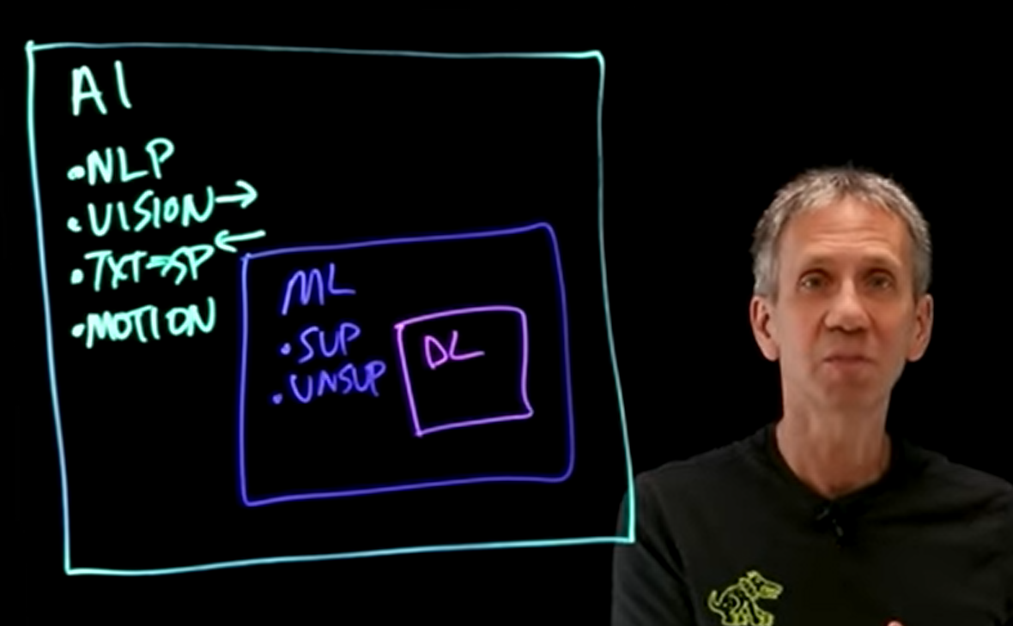
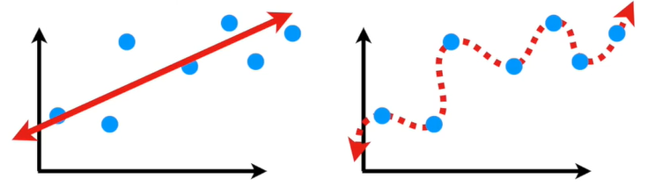
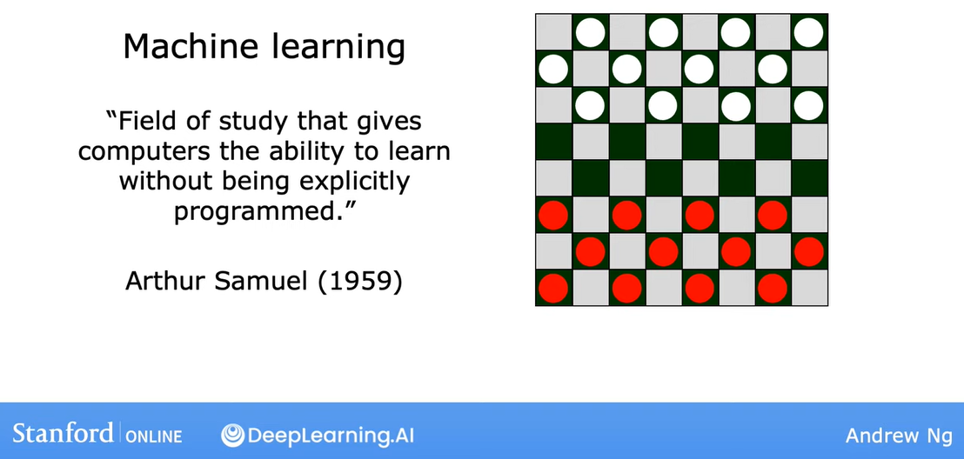
AI > ML > DL
https://www.youtube.com/watch?v=4RixMPF4xis

Slide 4

https://youtube.com/playlist?list=PLkDaE6sCZn6FNC6YRfRQc_FbeQrF8BwGI&feature=shared

Slide 5
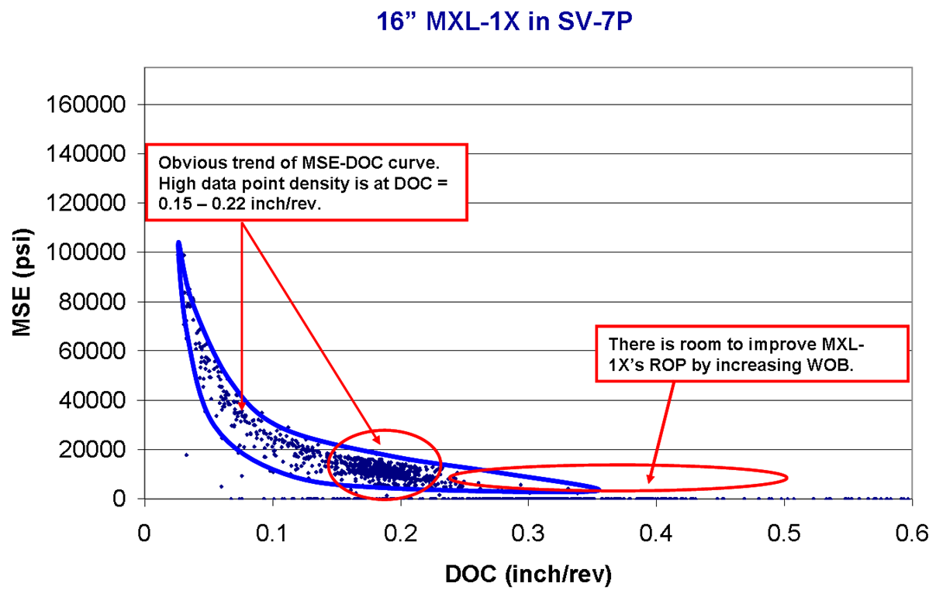
Methodology
As Mechanical Specific Energy (MSE) is the energy to remove a unit volume of rock, it is used to compare the relative hardness between cement interval.
MSE_{min} would linearly correlate Confining Compressive Strength (CCS) of the rock.
If drilling is inefficient zone, data points of MSE-DOC would be parallel DOC axis and MSE is reaching MSE_{min}

Slide 6
Workflow
Step 1: Plotting up to observe the trend of data point
Step 2: Using unsupervised machine learning (K-mean cluster) to cluster data based on important drilling parameters (WOB, TQ, DOC)
Step 3: Using supervised machine learning (Random Forest) to train on the drilling data for each cluster.
Step 4: Run Monte Carlo simulation with wide range of drilling parameters and the trained Random Forest of each cluster to seek MSE_{min} for each cluster.
Step 5: Plotting the result again with predicted MSE_{min} to ensure the prediction is relevant.
Step 6: Plotting up in WellCad as the final report
(All Python code for this study is available, please contact me if you would like to have)

Slide 7
Limitation
Drilling parameters are generally correlating to rock hardness but that correlation is usually non-linear.
Moreover, the drilling parameters are from surface measurement, thus there are energy loss from drill string and BHA.
If those factors impacting to the bit to drill cement is not changed significantly, relative comparison of one cluster to others for relative comparison of their hardness would be plausible.

Slide 8
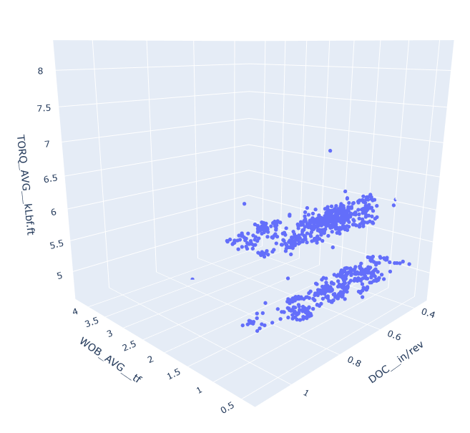
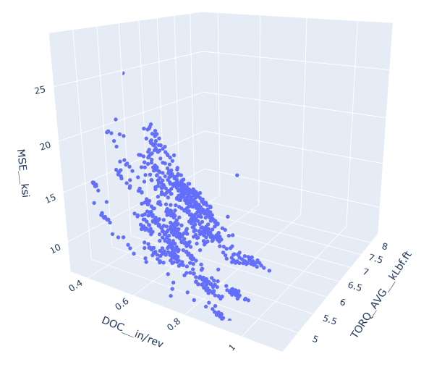
Step 1: Plotting up to observe the trend of data point
There were clear clusters in the plot of DOC – TQ – WOB, thus these parameters were used for K-mean clustering.

Slide 9
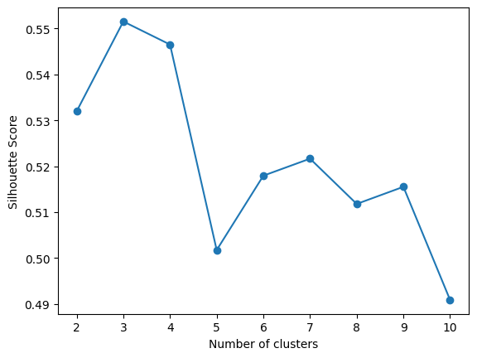
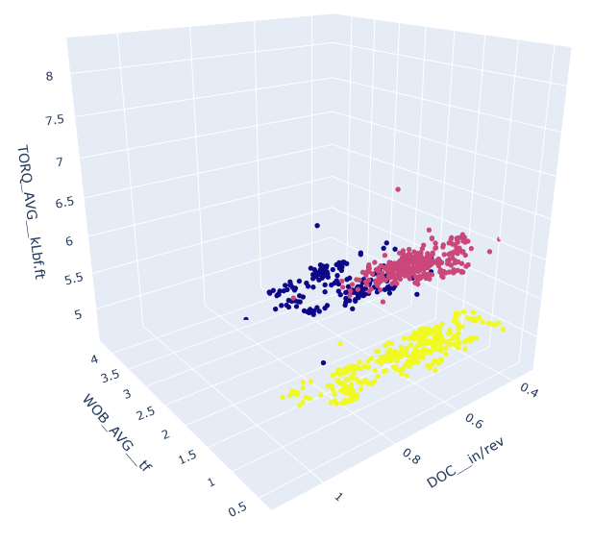
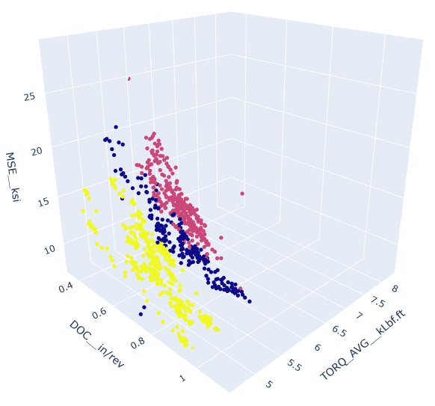
Step 2: K-mean Clustering with DOC, TQ and WOB
The algorithm is used Silhouette score to identify the optimum number of clusters, which cluster number with the highest score is the optimum. The algorithm automatically selected 3 clusters.

Slide 10
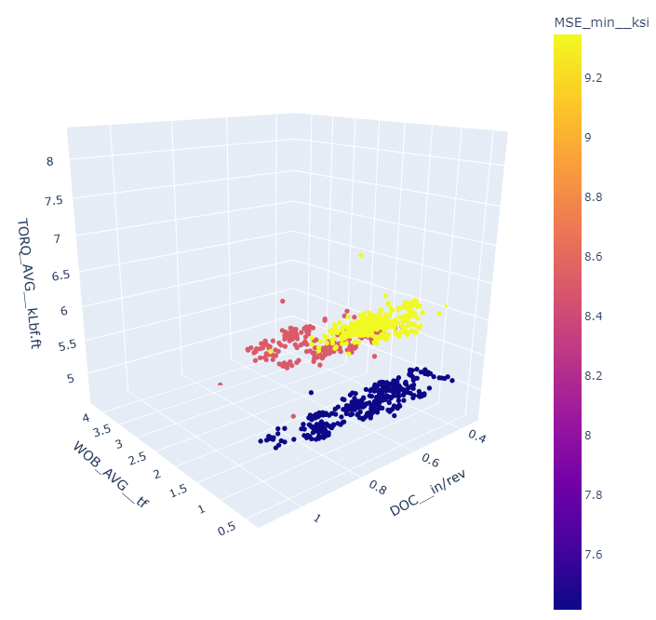
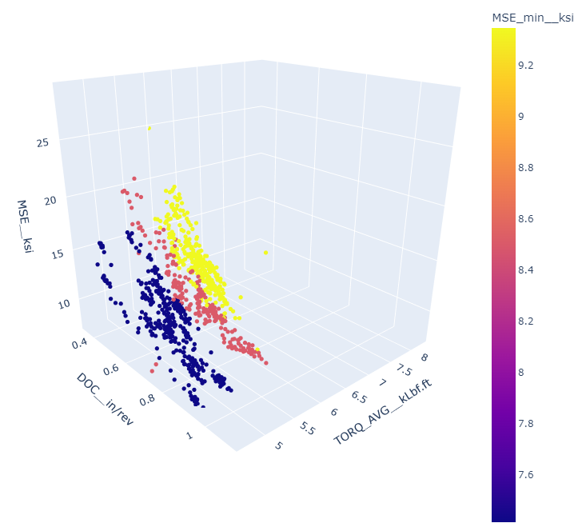
Step 3 & 4: Using Random Forest model to train on the drilling data for each cluster, and run Monte Carlo simulation with wide range of drilling parameters and the trained Random Forest of each cluster to seek MSE_{min} for each cluster. Step 5: Plotting the result again with predicted MSE_{min} to ensure the prediction is relevant.

Slide 11
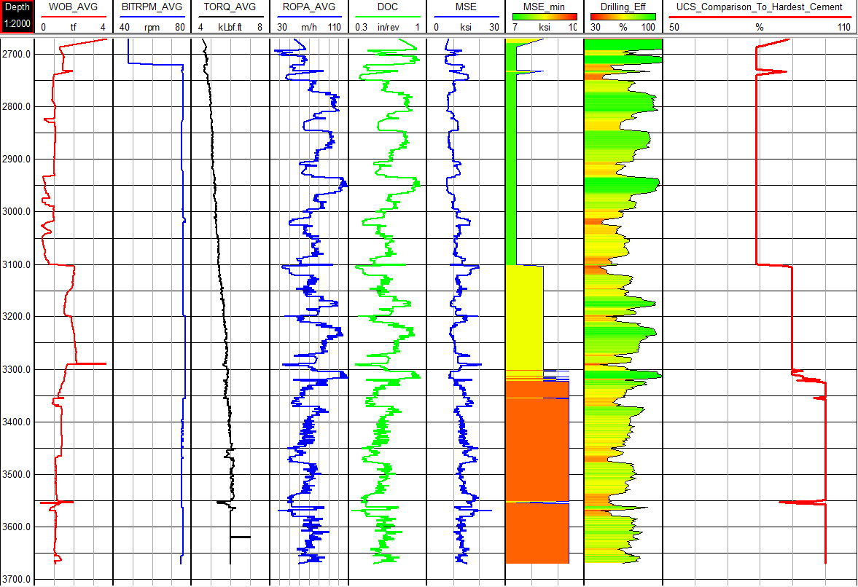
Step 6: WellCad
From the prediction, we can see that the cement at the lowest interval (from ~3,325ftMD)is the hardest.
The middle interval from 3,100ftMD to 3,325ftMD is about 90% hardness compare to the hardest.
The top interval until 3,100ftMD is the softest which is about 78% compared to the hardest.

Slide 12
Appendix – MSE Concept

Slide 13
Specific Energy and its Units
For decades, drilling researchers have found it advantageous to calculate the energy expended in removing a unit volume of rock.¹
The energy per unit volume of rock removed is called Specific Energy.
Specific Energy has the units psi.
Consider a PDC cutter like the one shown cutting a groove of area “A” with a force “F” that is “d” units long.
The energy (work) consumed is F * d.
The Volume removed is A * d.
The Specific energy, therefore has units of psi.
d
F
A
Energy Consumed
F * d
F
SE_{c} =
=
=
= PSI
Volume Removed
A * d
A
1 Teale, R., 1964, The concept of specific energy in rock drilling, Int. J. Rock Mech. Mining Sci. vol 2, pp 57-73.

Slide 14
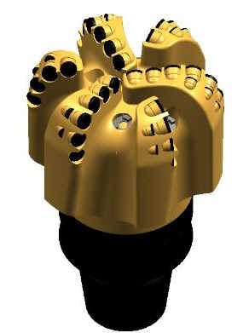
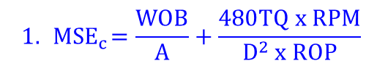
Forces On A Bit
There are two forces on a bit which produce work (or energy).
The bit weight acts through a distance as the bit advances
The forces on the cutters (torque) act through a much longer helical path as the bit advances.
We may derive an expression for the Specific Energy consumed by these two forces.
W
$$1. { MSE}_{c}=\frac{WOB}{A}+\frac{480TQ x RPM}{D^{2} x ROP}$$
WOB = bit weight (lbf)
TQ = bit torque (ft-lbf)
RPM = bit rotary speed (RPM)
A = area of the borehole bottom (in²)
ROP = penetration rate (ft/hr)
D = diameter of the borehole (in)
T
The first term results from the work done by the bit weight.
The second term results from the work done by the torque.

Slide 15
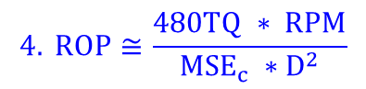
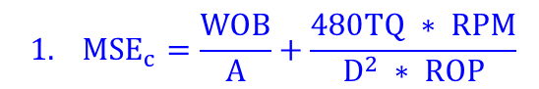
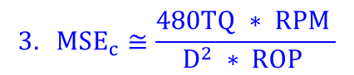
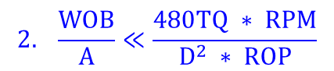
Close Approximation of SE_{c}
$$1. {MSE}_{c}=\frac{WOB}{A}+\frac{480TQ ∗ RPM}{D^{2} ∗ ROP}$$
It is easy to show that the second term in eqn. 1 is much larger than the first.
$$2. \frac{WOB}{A}≪\frac{480TQ ∗ RPM}{D^{2} ∗ ROP}$$
W
So, we can write:
$$3. MSE_{c}≅\frac{480TQ ∗ RPM }{D^{2} ∗ ROP }$$
Solving this for R, yields a simple Specific Energy based ROP model:
T
$$4. ROP≅\frac{480TQ ∗ RPM}{MSE_{c} ∗D^{2}}$$
Equation 4 is important because it indicates that ROP is caused primarily by torque.

Slide 16
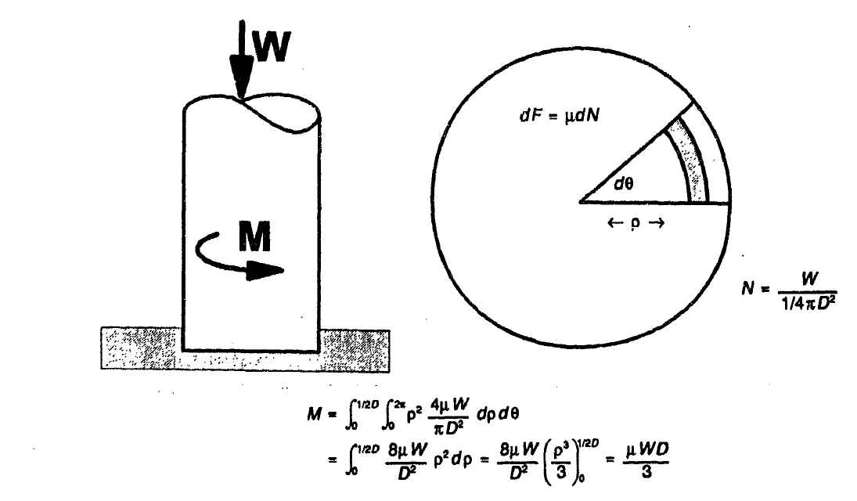
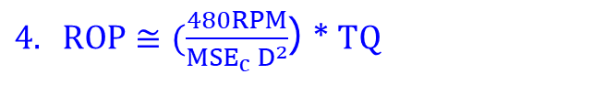
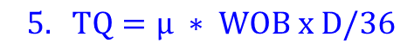
μ and Bit Weight
$4. ROP≅(\frac{480RPM}{MSE_{c} D^{2}}$) *$TQ$
Equation 4 indicates ROP is caused primarily by torque.
But there is not a “torque” knob in the doghouse that the driller can adjust to change the torque.
The driller controls the torque indirectly by changing the bit weight.
Rolf Pessier and Martyn Fear introduced a simple expression for estimating torque as a function of bit weight, based on a coulomb friction model of a disk rotating on a flat surface.²
$$5. TQ=μ ∗ WOB x D/36$$
WOB = bit weight (lbf)
TQ = bit torque (ft-lbf)
D = diameter of the borehole (in)
We call μ the “aggressivity” of the bit.
Equations 4 and 5 together constitute a simple two-parameter drilling model.
2 Pessier, R.C. and Martyn Fear, “Quantifying Common Drilling Problems with Mechanical Specific Energy and a Bit-Specific Coefficient of Sliding Friction,” SPE 24584, 1992.

Slide 17
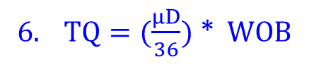

Two Term ROP Model
These two equations, copied from the previous slide, constitute a simple two-parameter ROP model.
$6. TQ=(\frac{μD}{36})$ *$WOB$
$7. ROP≅(\frac{480RPM}{MSE_{c} D^{2}}$) *$TQ$
Equations 6 and 7 suggest (with some admitted over-simplification) that we can think of drilling as a two step process:
The driller applies weight. The weight generates torque.
That torque causes ROP.

Slide 18
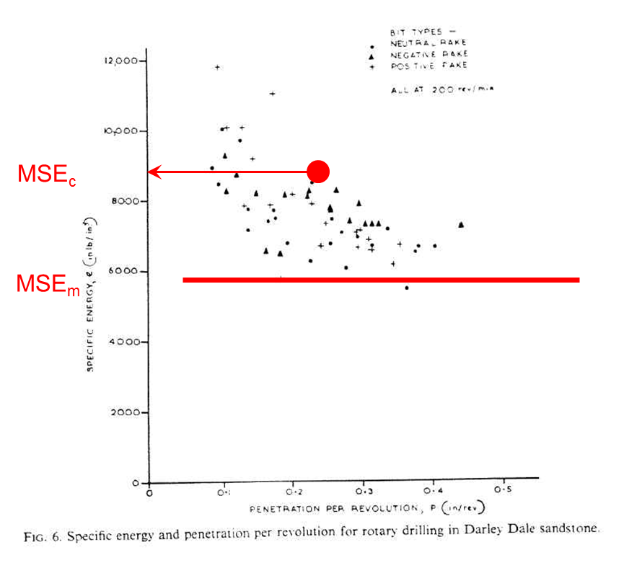
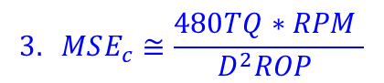
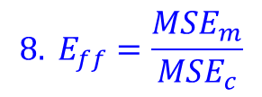
Efficiency
Equation 3, repeated below, is a means to calculate the Specific Energy actually consumed in a drilling process, as a function of drilling parameters.
For any given drilling environment (rock type and downhole stress) there is a minimum specific energy (SE_{m}) required to drill the rock efficiently.
The Specific Energy actually consumed (SE_{c}) is usually higher than the minimum Specific Energy (SE_{m}).
We define a drilling efficiency as:
$$3. MSE_{c}≅\frac{480TQ∗RPM }{D^{2}ROP }$$
$${8. E}_{ff}=\frac{MSE_{m}}{MSE_{c}}$$
MSE_{m}:
Minimum MSE with which you could expect to drill this rock if you did everything right.
Atmospheric pressure, MSEm happens to be numerically close to the UCS of the rock.

Slide 19

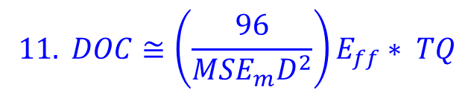
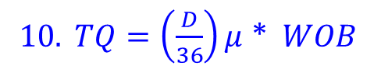
ROP in Terms of Penetration per Revolution
It is often convenient to express ROP as Depth of Cut(DOC).
$$9. DOC=\frac{ROP}{5∗RPM}$$
RPM = bit rotary speed (RPM)
ROP = penetration rate (ft/hr)
DOC = Depth of Cut (in/rev)
Plugging the expression for PPR (eqn. 9) and the expression for efficiency (eqn. 8) into equation 7, we may rewrite the two parameter drilling model as:
Everything in the parentheses is a constant, for a given bit diameter in a given drilling environment.
Equation 10 says the bit weight will generate torque governed by the aggressivity, μ.
Equation 11 says the torque will make hole at a rate governed by the efficiency, E_{ff}.
$10. TQ=\left(\frac{D}{36}\right)μ$ *$WOB$
$$11. DOC≅\left(\frac{96}{MSE_{m}D^{2}}\right)E_{ff}∗ TQ$$
These two parameters, aggressivity and efficiency, govern ROP, in this two-parameter model.

